Slide 1
Artificial Bone ScafFold
By: Eloy Marquez, Undergraduate Aerospace Engineer, NMSU
Mentor: Dr. Vincent Choo, Ph. D., Professor of Mechanical Engineering, NMSU

Slide 2
Thirteenth Annual Undergraduate Research and Creative Arts Symposium
Undergraduate Research Assistantship Program (URA)
Alliance for Minority Participation (AMP)

Slide 3
Introduction
One major challenge in natural bone repair is the inability to regenerate when there is a major tissue loss (NMSU: Research, 2008).
The global purpose of the research is to design and fabricate scaffolds that are biocompatible and biodegradable.
This scaffolds can be used to encourage bone regenerate in cases of severe bone loss.
The first step of the research is to develop a process to successfully leach salt from a scaffold polymer specimen.
The process includes calibration of sonic washer apparatus.

Slide 4
Background, problem and purpose

Slide 5
Background
A modern and advance application of polymers is to replace organic tissue.
One of numerous applications is the replacement of bone tissue.
The bone tissue polymer has to be bio-degradable, porous and mechanical strong.

Slide 6
Problem
In the process of forming the polymer the polymer is mixed in a solid state with solid salt.
The solid mixture is heated and cooled down at a temperature were the salt is still solid but the polymer becomes liquid.
The salt is aggressive to the human tissue, so it is required that all the salt is removed

Slide 7
Purpose
The purpose of the research is to achieve a reliable method for leaching all the salt out of the polymer and to calibrate the washing apparatus.
Calibration:
X – Ray
Water Flow

Slide 8
Methodology and objectives

Slide 9
Methodology and objectives
The proposed methodology is to use ultrasonic waves to assist in leaching the salt out of the scaffolds. The main objectives to accomplish are:
Design and construction of ultrasonic salt leaching device.
Calibration of this device.
Perform actual salt leaching test using rod scaffold specimens.
Verification of complete salt removal from scaffolds. (X-ray, scanning electronic microscopy with EDX facility, chemical compounds analysis).
Write up a research report.

Slide 10
Manufacturing Process

Slide 11
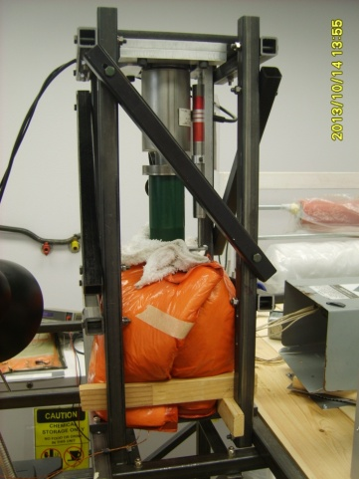
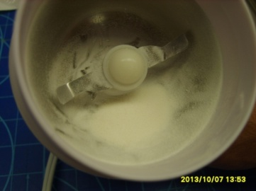
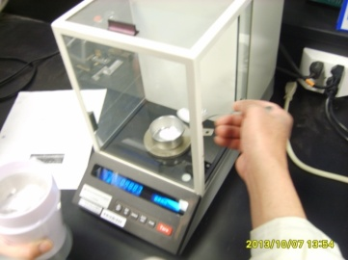
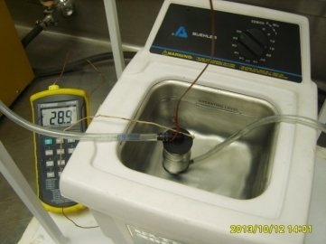
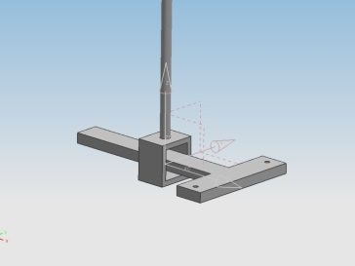
Manufacturing Process
Steps:
Grind Material
Mix at certain %
Heat forming
Ultrasonic Wash
Compression Test
X – Ray

Slide 12
Results

Slide 13
Results
An effective continuous and adjustable water flow was obtained using a gravity feed washing apparatus.
Temperature inside the cylinder that contains the scaffold was reduced from +50° C to less than 34° C.
The washing time was about 14 hours. This time was found using X - rays imaging.
Some pieces of polymer were found in the water used for washing the scaffold indicating that the process of manufacturing need to be improved.

Slide 14
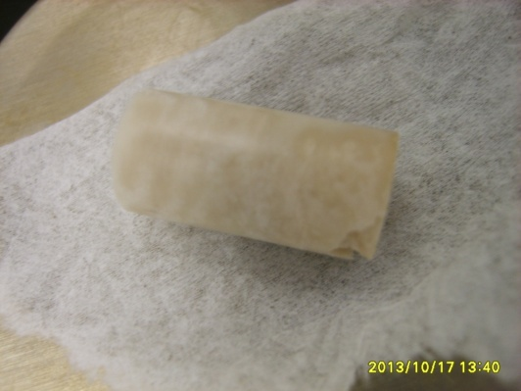
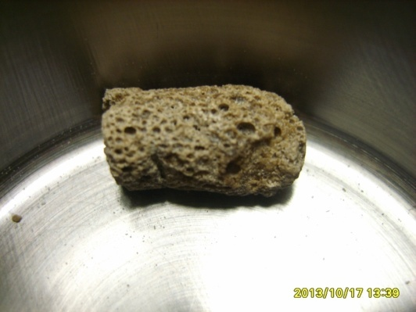
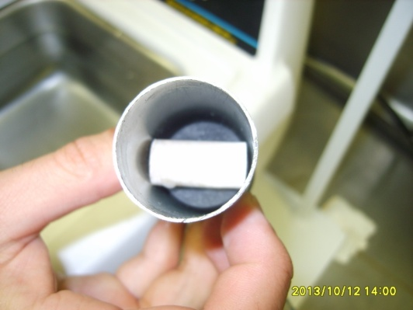
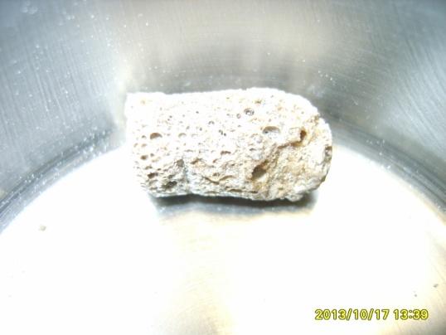
Results
Before
After
Resine + Salt
14 hours of washing

Slide 15
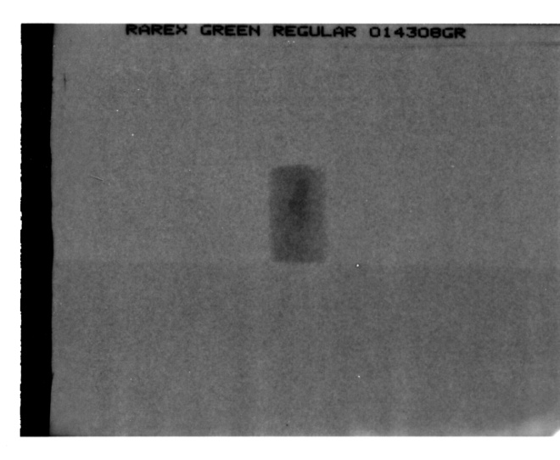
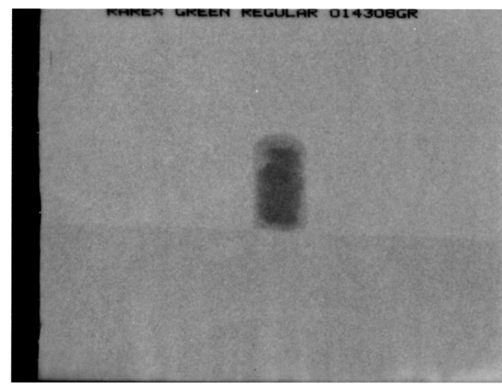
X - Rays
From left to right
1 hour, 5 hours, 11 hours, 15 hours… time of being in the washing machine.
1 hour
5 hours
11 hours
15 hours

Slide 16
Conclusions

Slide 17
Conclusions
The process of manufacturing and washing was successfully improved.
The method of using of ultrasonic waves to leach the salt out the scaffolds was proved.
Final salt concentration needs to be found.
The washing machine will be upgraded so it can wash more than one scaffold at the same time (max three).
When complete salt removal is accomplished and verified the scaffold will be subjected to mechanical tests to found its properties.

Slide 18
Questions
Feel free to ask!
Or stop by our booth later today!

Slide 19
Acknowledgements

Slide 20
Acknowledgements to:
New Mexico AMP for their support and guidance.
NMSU ME department and M-Tec for their interest in our education and their continuous quest for improvement.
Dr. Choo for his mentoring and many teachings.
Kyle Glen for his work and collaboration in this project.
Finally, but not least, to my family, friends and other people that help us.

Slide 21
Thank you for your attention

