Slide 1
Effect of evaporation reducers on concrete shrinkage
By: Armando De La Cruz
Faculty Mentor: Dr. Craig M. Newtson

Slide 2
Purpose
Assess the effectiveness of the evaporation reducer, a.k.a Confilm®, in terms of its ability to minimize early-age
shrinkage in concrete.
Perform routine slump, compressive strength and flexural strength tests.
Gain a deeper understanding of concrete construction.
Be exposed to the engineering design of concrete mixtures.

Slide 3
Description
Follow-up work to a study that evaluated early-age shrinkage in concrete cured by misting and wet curing.
Comparisons will be made to the original experimental results to assess the effectiveness Confilm®.
Types of tests performed
Towels, no Confilm®
No towels, no Confilm®
Confilm® and towels
Confilm® only

Slide 4
Project Importance
Shrinkage cracks allow the infiltration of water, salts, and chemicals into concrete. This can lead into the following:
Damage and corrosion of reinforcing steel
Degradation of the concrete
Decreased service life of the concrete
Possible failure of a structure

Slide 5
Methodology
Materials
There are five basic constituents in the concrete used:
Cement -(Type I-II Portland Cement with a specific gravity of 3.15)
Coarse Aggregate - (Specific Gravity of 2.55, absorption of 1.85 percent, and a 3/4 inch top size)
Fine Aggregate -(Specific Gravity of 2.54, absorption of 1.14 percent)
Water
Air

Slide 6
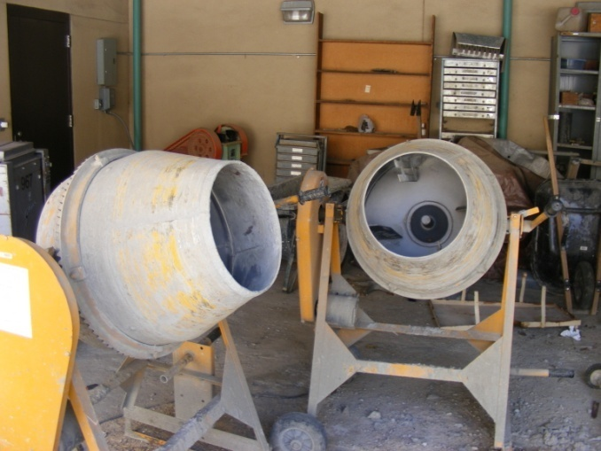
Mixing Procedure
Mixed according to ASTM C 192 (American Society for Testing and Materials)
Materials had to be placed in two mixers: 53 % in the first, and 47% in the second
The batch size for each of the tests was 3.50 ft³
After mixing, ASTM C 143 slump test was performed to measure the workability of the concrete
Picture of mixers used
Example of ASTM C 143: slump test

Slide 7
Specimen Preparation
Specimens were produced by placing concrete into the following mold sizes and quantities:
One 3ft x 1.5 ft x 0.5 ft (914.4x457.2x152.4 mm)wooden mold lined with two layers of plastic and talc in between the layers
Three 4 x 8 inch (102x203.2 mm)cylinders
Four 3 x 4 x 16 inch (76.2x102x406 mm) prisms

Slide 8
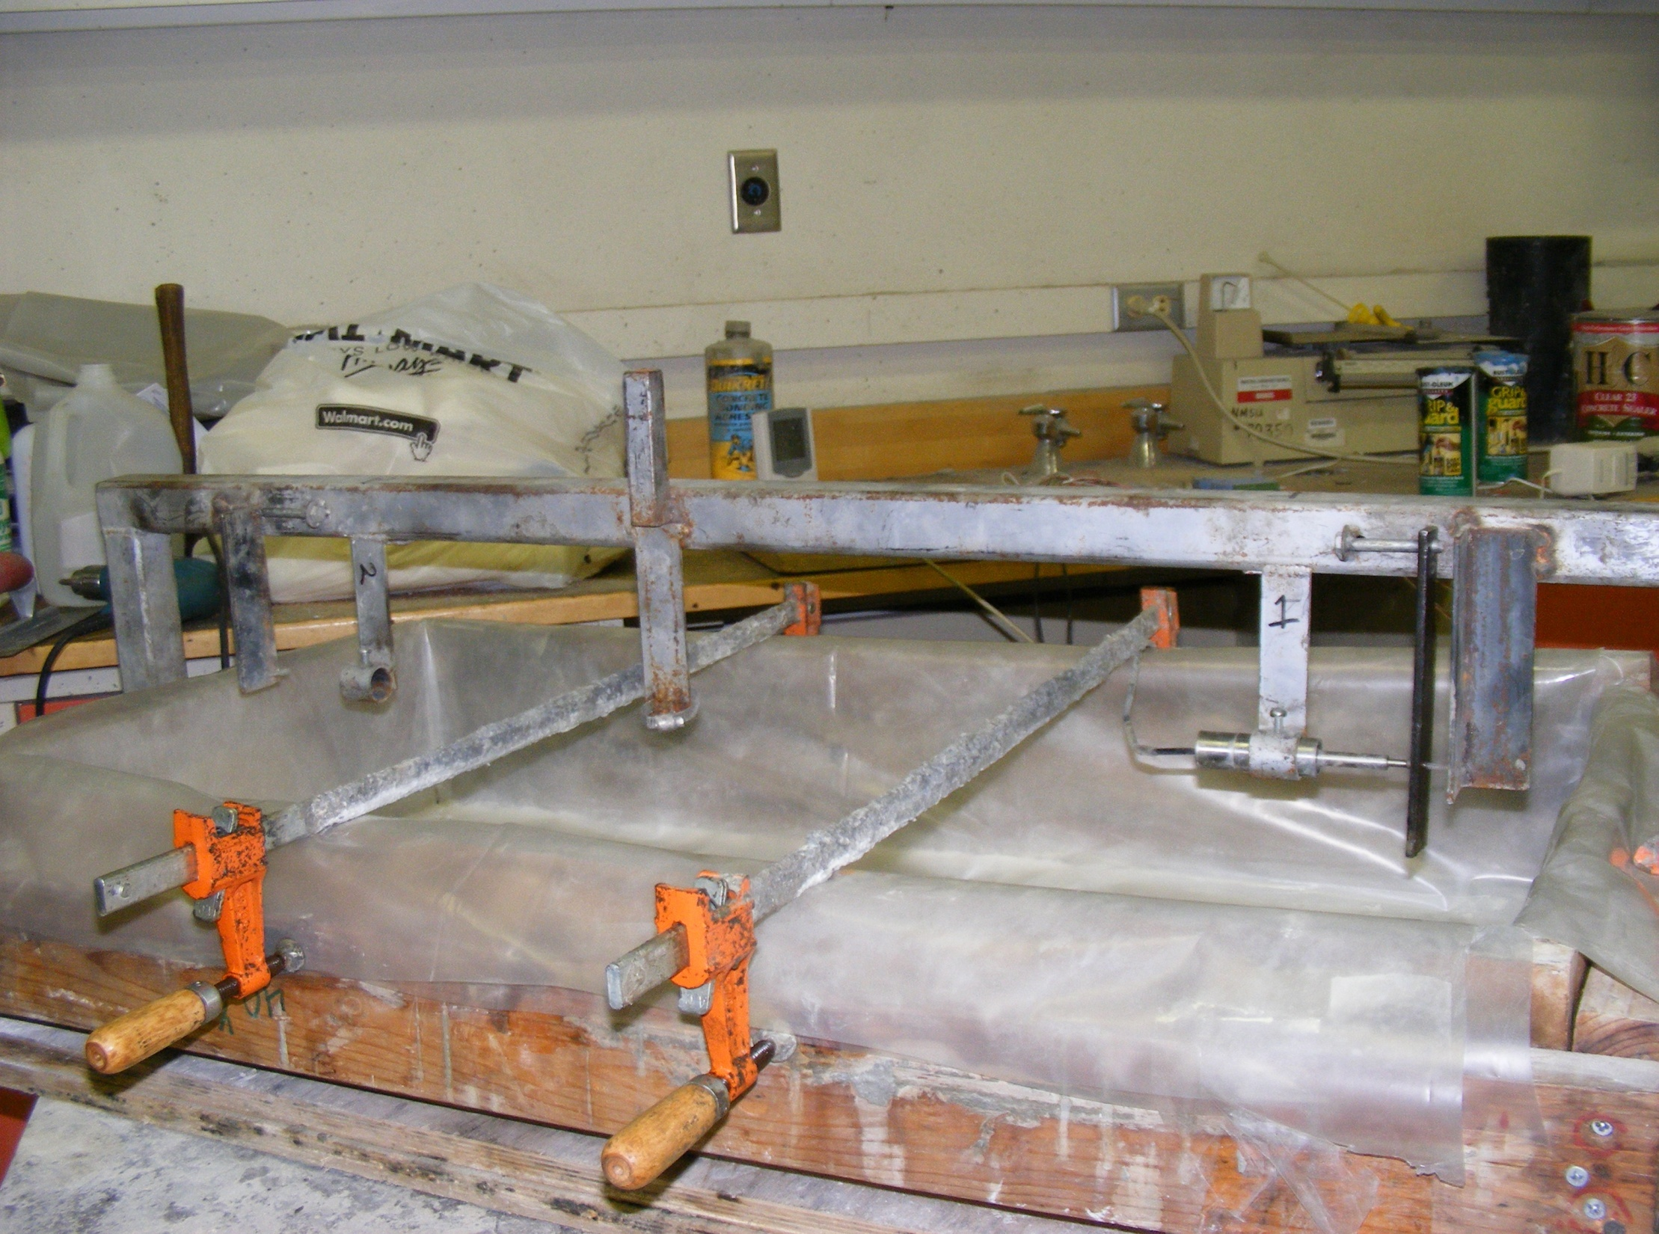

Slide 9
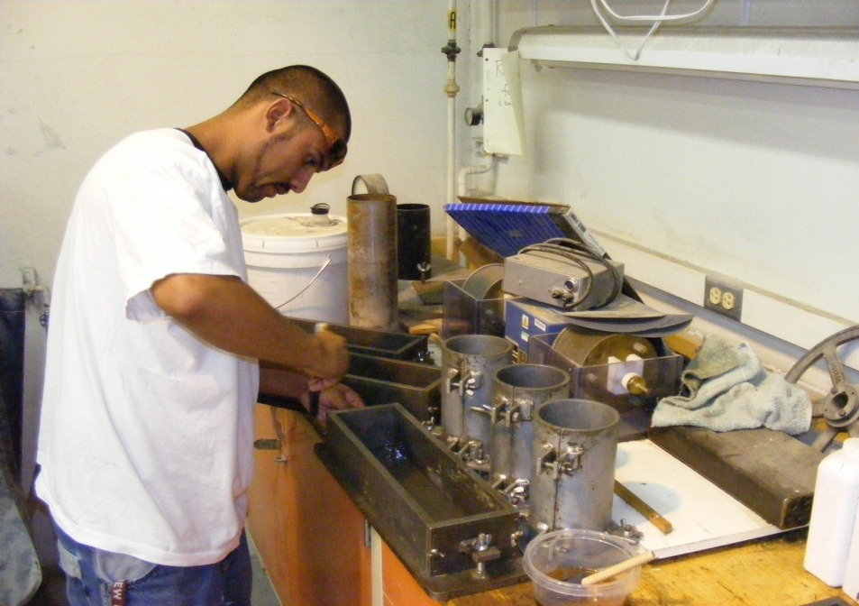
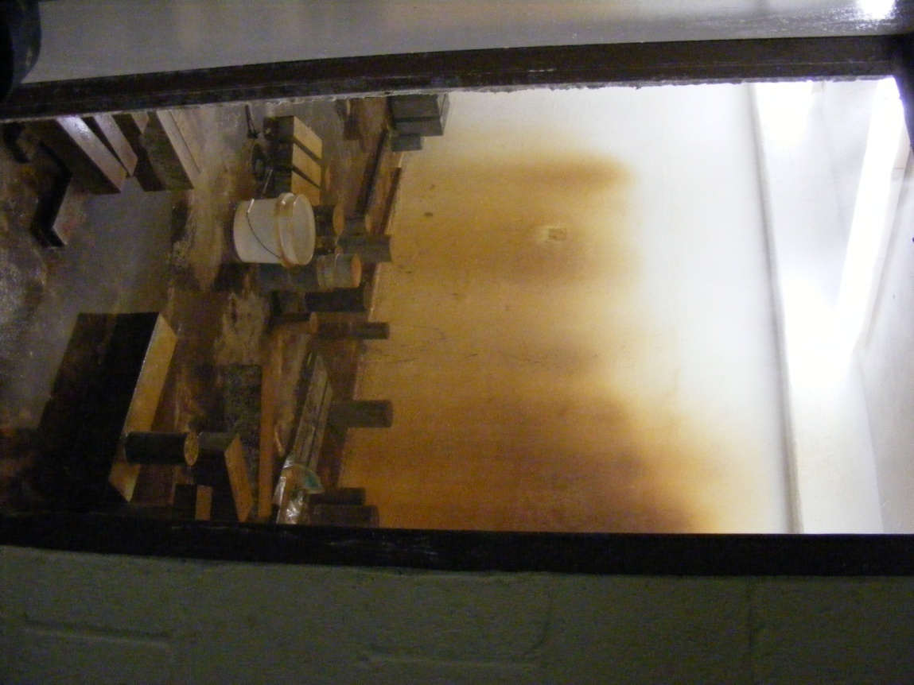
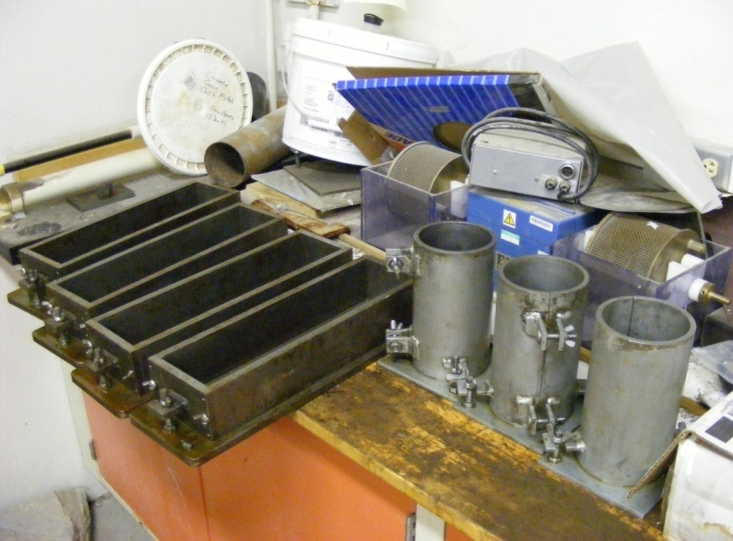
Picture of molds
Picture of curing room used for cylinders

Slide 10
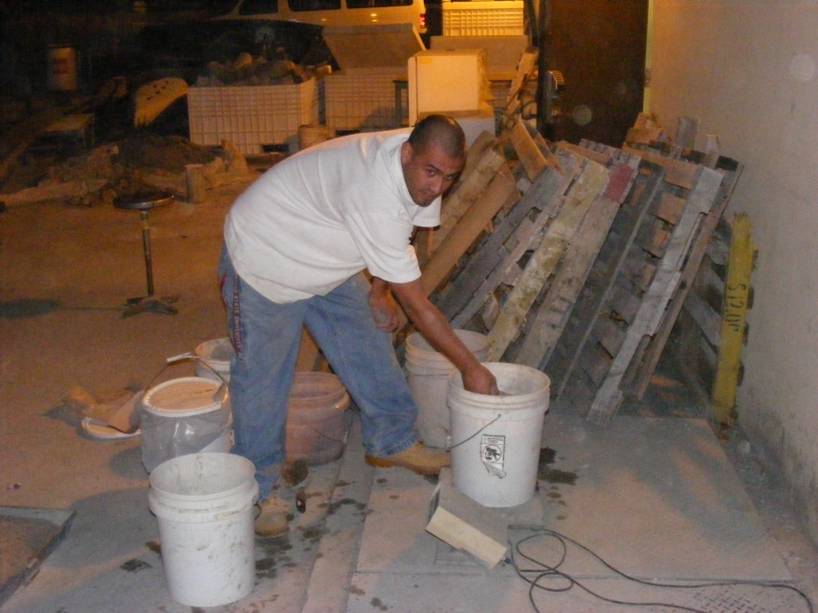
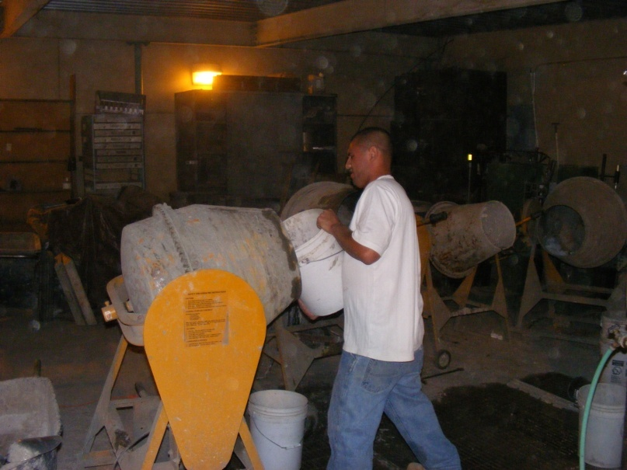
Weighing the constituents.
Placing constituents into the mixers.

Slide 11
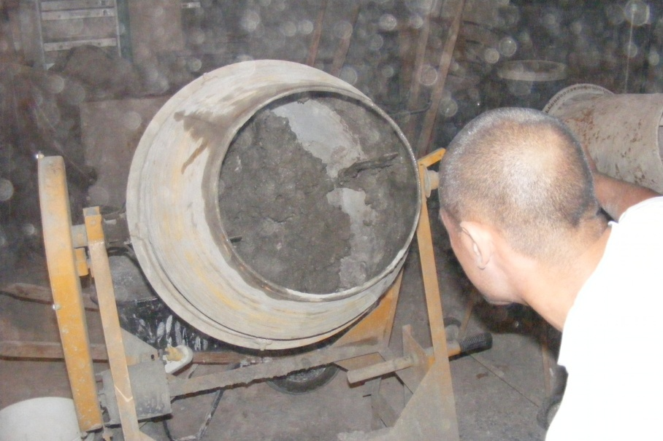
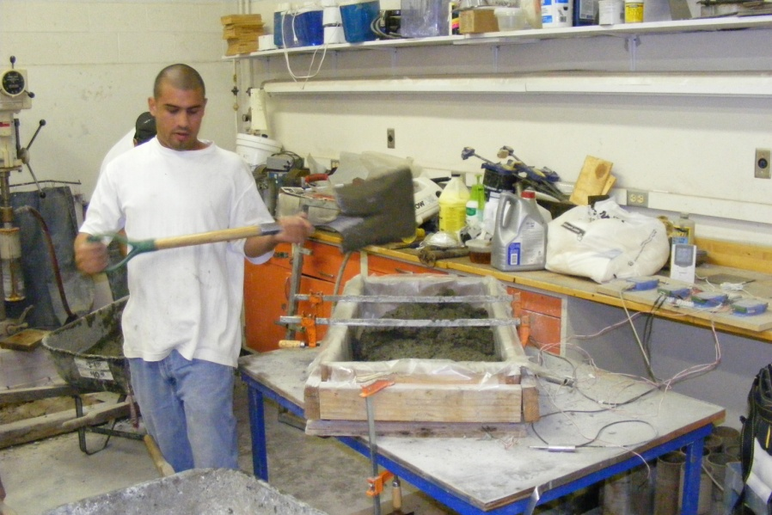
Checking for clumping .
Placing cement into molds and specimen.

Slide 12
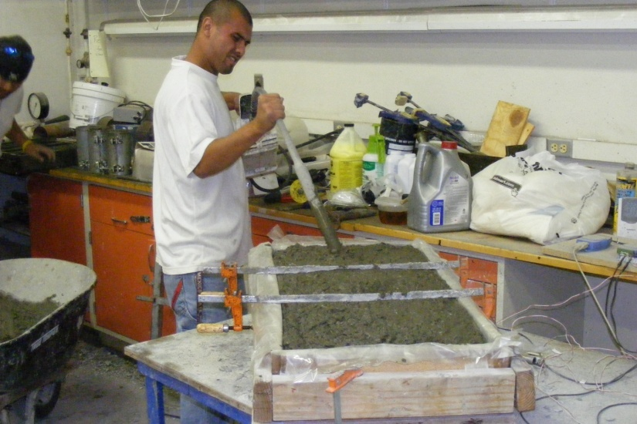
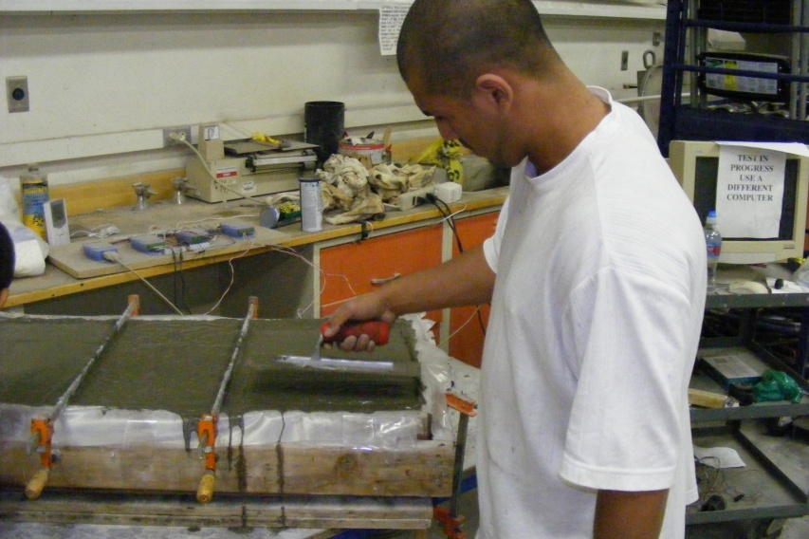
Consolidating with electric vibrator.
Troweling surface for smooth finish.

Slide 13
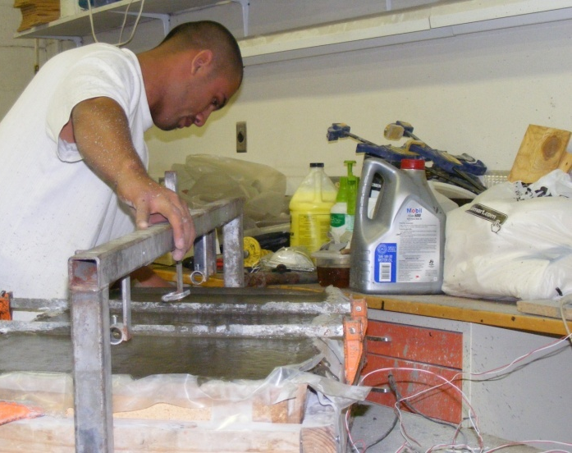
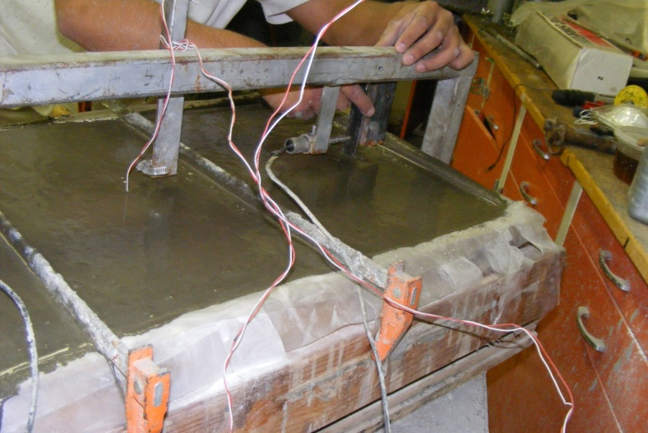
Placing frame used to hold LVDT’s.
Inserting hangers and LVDT’s.

Slide 14
Data Acquisition
Computer hardware used to collect the data was Super Logics WINview CP 32.
Two Super Logic Analog Input Modules
Two LVDT’s (linear variable differential transformer)
Two thermocouples

Slide 15
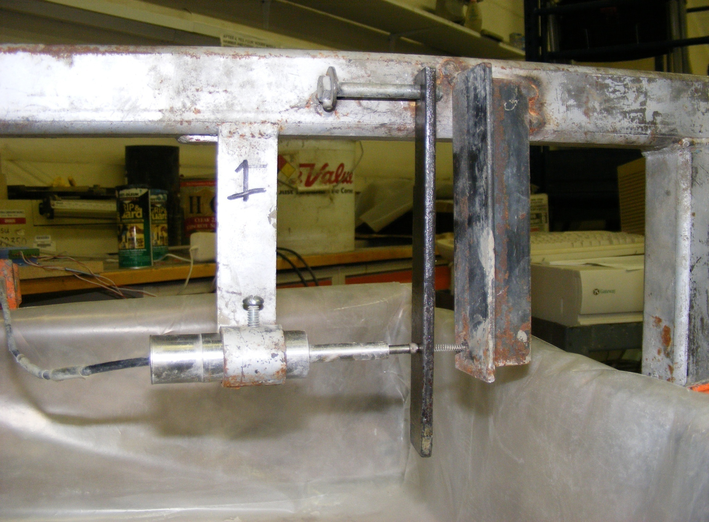
Hangers
LVDT
Resistance spring

Slide 16
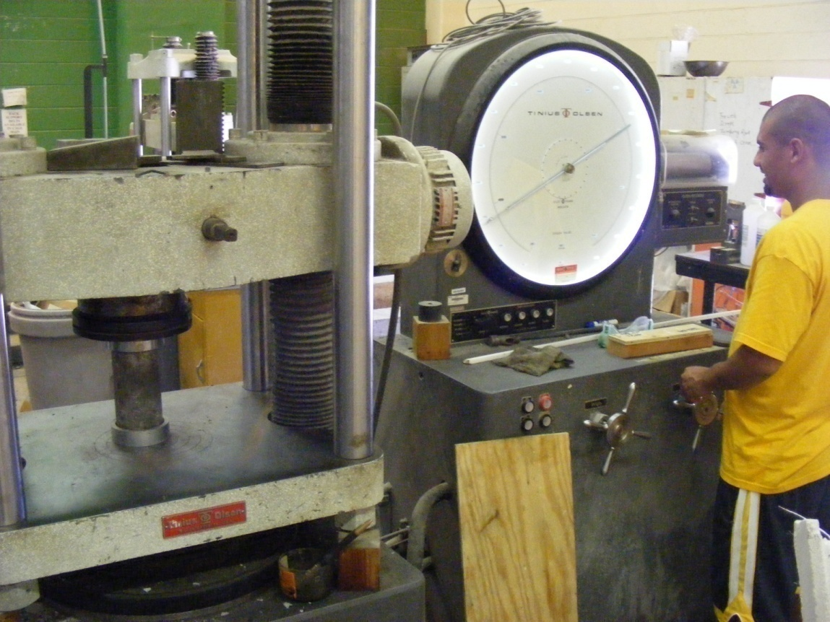
Strength Testing
Compressive Strength Test (ASTM C 39)
Modulus of Rupture Test (ASTM C 78)

Slide 17
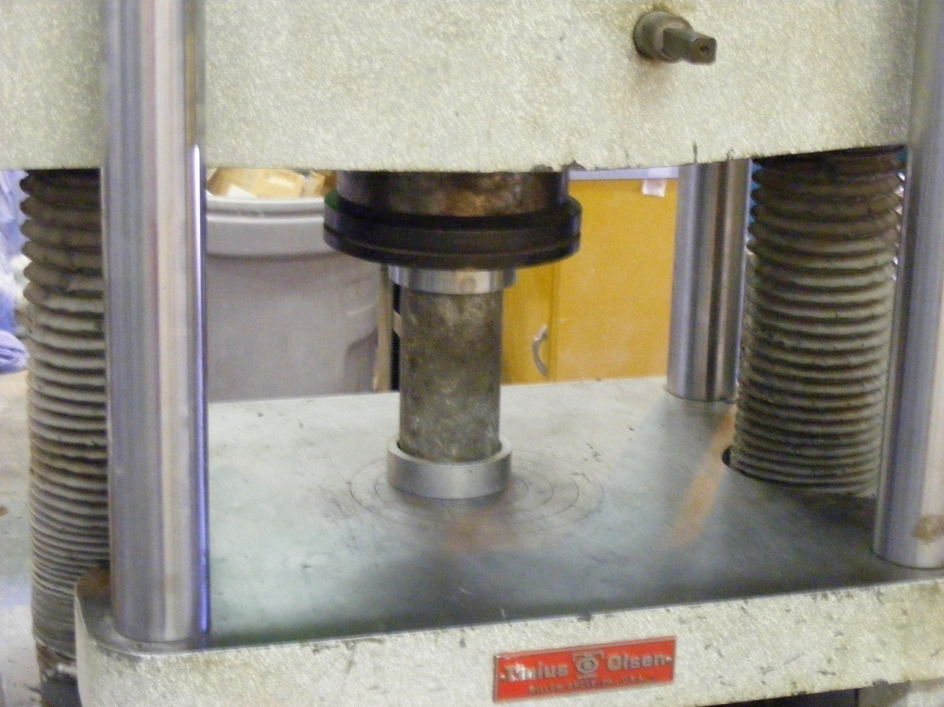
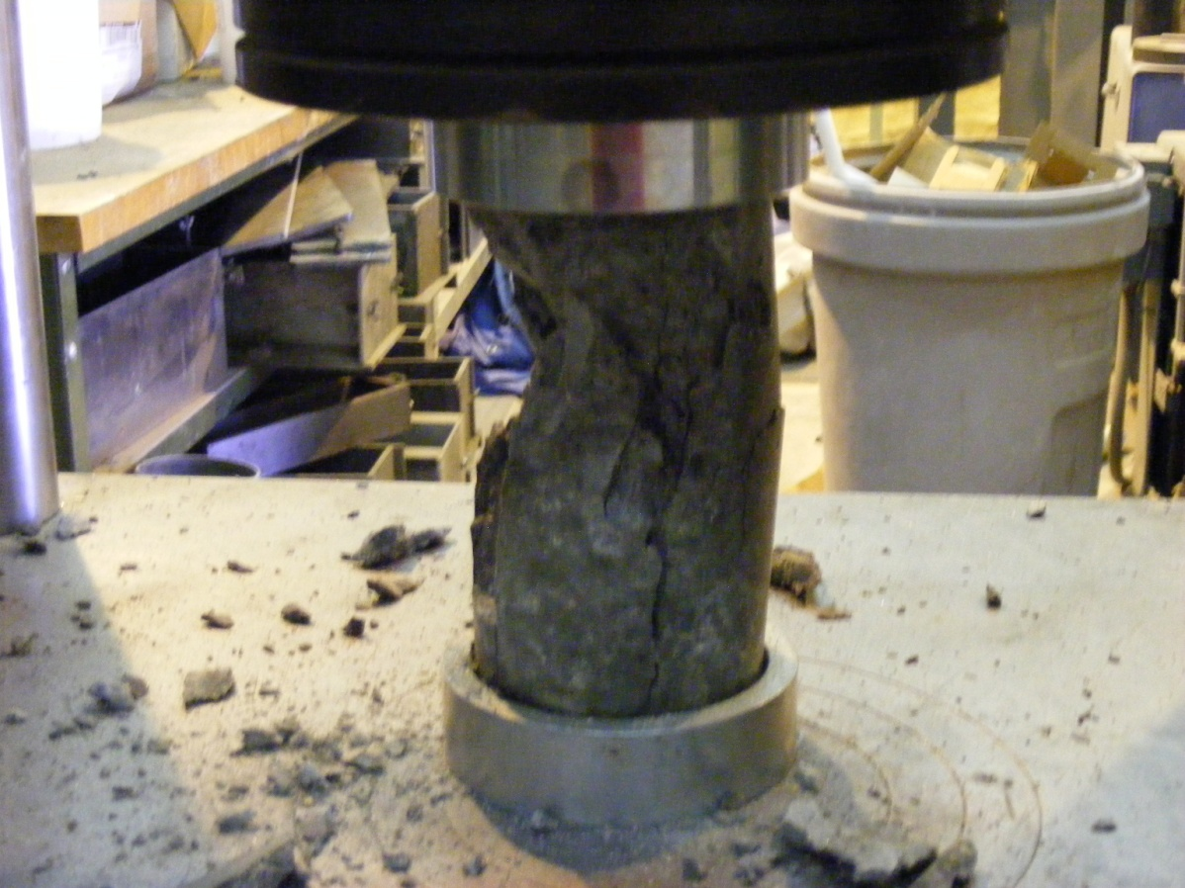

Slide 18
Results
Average Compressive Strengths of Tests
Average Tensile Strengths of Tests
Test | MPa | (psi)
Dry Tests | 38.03 | 5516
Towel Tests | 32.93 | 4777
Confilm® Tests | 30.71 | 4454
Confilm®/Towel Tests | 32.38 | 4697
Test | MPa | (psi)
Dry Tests | 4.48 | 650
Towel Tests | 3.95 | 573
Confilm® Tests | 4.11 | 597
Confilm®/Towel Tests | 4.57 | 663
Tests which used only Confilm® produced least amount of compressive strength.
(4454 psi)
Reduction of compressive strength by 19.3%.
Reduced tensile strength by 8.0%.

Slide 19
Average Horizontal Strain Measurements
No curing aids-1000µε Wet towels only-200µε
Only Confilm®-147µε Towels and Confilm®-310µε

Slide 20
Conclusion
When using Confilm, shrinkage decreased by 85.3%.
(1000µε to 147µε)
The use of confilm can be suitable in situations where the engineering properties of the concrete are not important (i.e. driveways, landscaping).
More experimentation is still required to establish a more accurate understanding of Confilm’s effect on concrete under varying outdoor conditions.

Slide 21
Special Thanks:
New Mexico AMP
Dr. Craig M. Newtson
Christian Dominguez
National Science Foundation

Slide 22
Questions?

