Slide 1
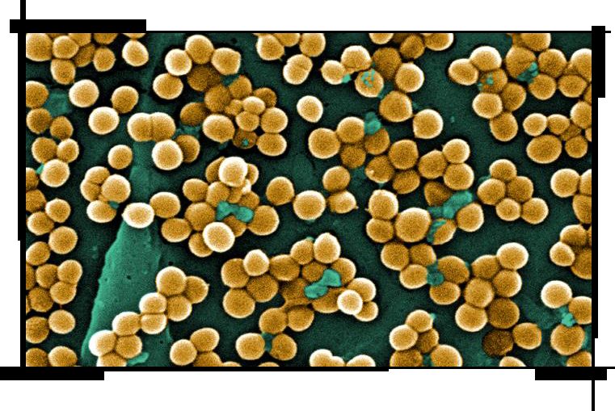
John Rivera

Slide 2
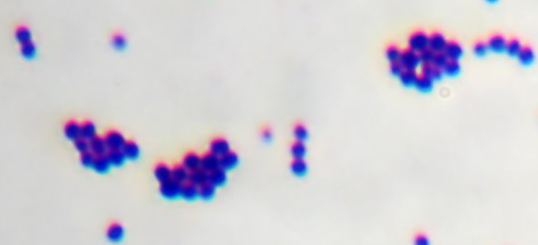
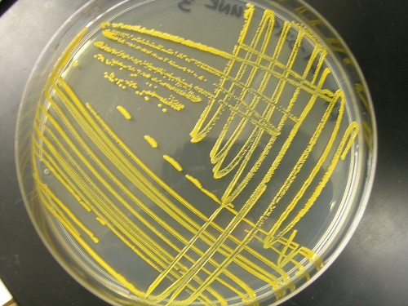
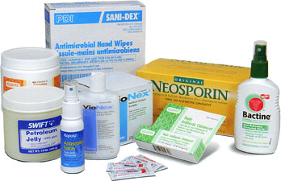
Background
Gram-positive
Methicillin-resistant Staphylococcus aureus (MRSA)
Nosocomial and community-acquired (CA) infections

Slide 3
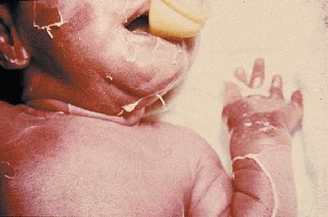
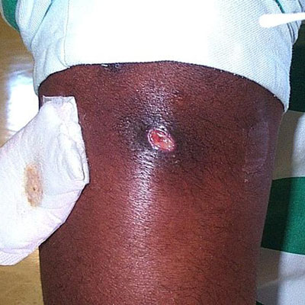
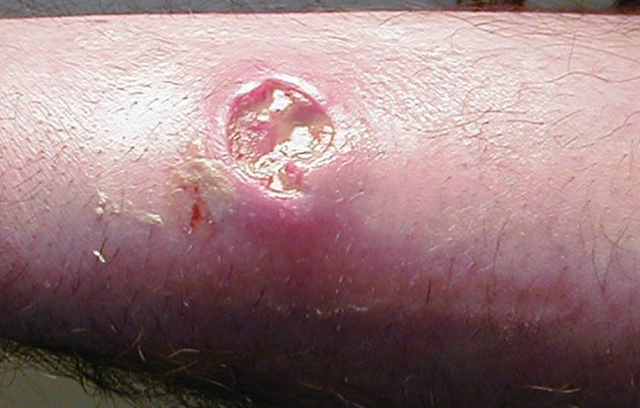
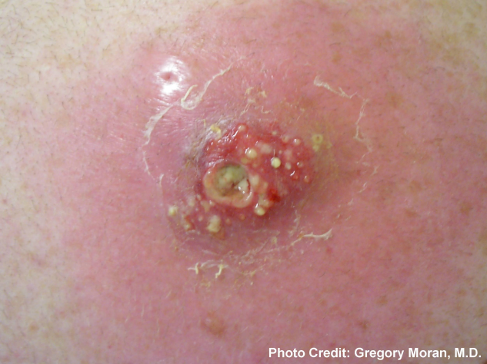
Infections

Slide 4
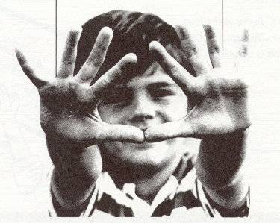
Transmission/Prevention

Slide 5
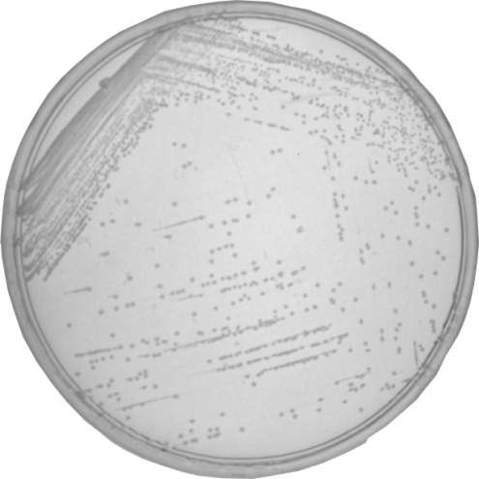
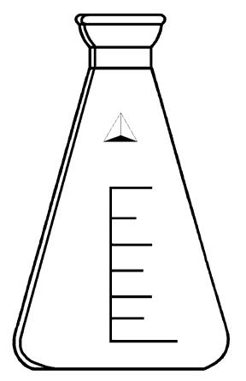
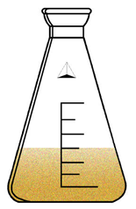
Step-wise Adaptation for ethanol-reduced susceptibility (ERS) mutants
Parent Strains
(SH1000&COL)
Ethanol

Slide 6
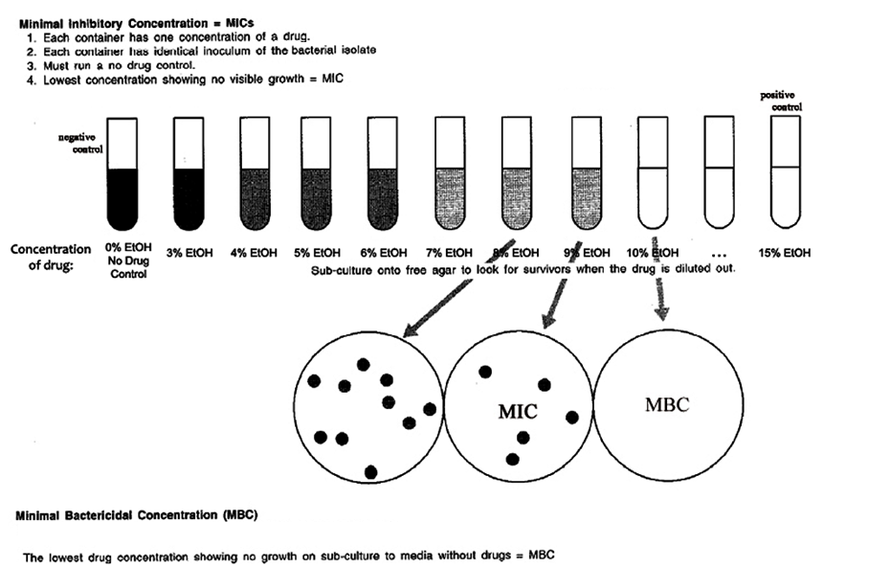
MIC and MBC’s

Slide 7
MIC/MBC Results
MIC (n =3) ± SD MBC (n =3) ± SD
_______________________________________________________________________
SH1000 8.3 ± 0.6 12.0 ± 1.0
SH1000-15.1 10.7 ± 0.6* 14.3 ± 1.2*
SH1000-15.2 9.0 ± 0 13.0 ± 0
SH1000-15.3 8.7 ± 0.6 12.7 ± 1.5
COL 6.3 ± 0.6 12.3 ± 0.6
COL-14.1 8.0 ± 0* 10.7 ± 0.6*
COL-14.2 8.0 ± 0* 10.3 ± 0.6*
COL-14.3 8.0 ± 0* 11.3 ± 0.6
COL-15.1 8.0 ± 0* 14.0 ± 1.0
COL-15.2 7.3 ± 1.0 13.7 ± 1.2
COL-15.3 7.6 ± 0.6* 13.3 ± 1.5
_______________________________________________________________________
*p ≤ 0.05
p ≤ 0.1

Slide 8
COL & COL ERS Mutants in the Presence of 3% EtOH

Slide 9
SH1000 & SH ERS Mutants in the Presence of 3% EtOH

Slide 10
Staphyloxanthin
OD₄₂₅nm (n =3) ± SD
_______________________________________________________________
SH1000 0.0343 ± 0
SH1000-15.1 0.0103 ± 0*
SH1000-15.2 0.0203 ± 0*
SH1000-15.3 0.0147 ± 0*
COL 0.0380 ± 0
COL-14.1 0.0423 ± 0*
COL-14.2 0.0457 ± 0*
COL-14.3 0.0400 ± 0
_______________________________________________________________
*p ≤ 0.05

Slide 11
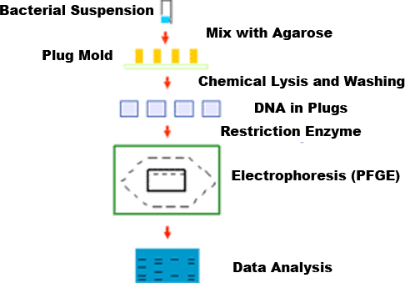
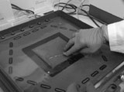
Pulse-field gel electrophoresis

Slide 12
Conclusion
Using a stepwise selection ERS SH1000 and COL mutants were isolated
ERS mutants did demonstrate higher MIC/MBCs
Differences in ethanol susceptibility and ERS mutants suggest an ethanol stress mechanism exists in S. aureus

Slide 13
Future Direction
Physiological growth experiments
Comparative-genomic sequencing (CGS)

Slide 14
Acknowledgements
The whole Staph Lab
Minority Access to Research Careers (MARC)
The National Institutes of Health: SC1AI081425-02 (JEG), S06 GM008136-32 and (JEG, NMSU SCORE PROGRAM); R25 GM07667-30 (NMSU-MARC PROGRAM); S06 GM61222-05 (NMSU-MBRS-RISE PROGRAM); and P20RR016480 from the NM-INBRE Program of the National Center for Research Resources. JEG also acknowledges the NMSU Undergraduate Howard Hughes Medical Institute Program (52005881).

