Slide 1


The Elasticity of (Fe,Ni) Alloys and the Composition of the Earth’s Core
Owen Boberg
Dave Emery, Boris Kiefer
Department of Physics

Slide 2
Planetary Cores and Astronomical Observations
Earth’s Moment of Inertia not consistent with a homogeneous sphere.
For a homogeneous sphere I = 0.4, I_{Earth}= 0.33.
Suggests heavy material is concentrated toward the center of the Earth.
Heavy element toward the center of the Earth.

Slide 3
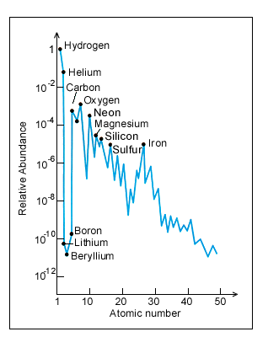
Nuclear Synthesis
Relative to Sun
Iron is very abundant
Iron is very dense
Iron will sink due to gravity.
Iron
http://www.fas.org
Iron is abundant and heavy.

Slide 4
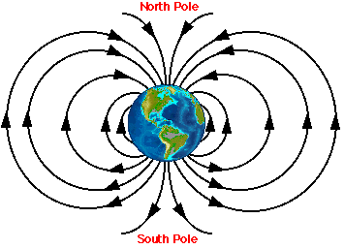
Local Magnetic Field
Prerequisites:
Liquid.
Rotating.
Electrical conductor.
Abundant metal like iron
is a prime candidate for a
core material.
http://www.physics.ubc.ca/
Iron is a good candidate for core materials.

Slide 5
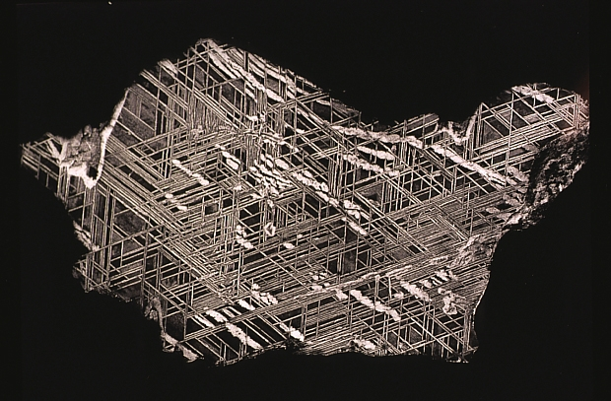
Cosmochemistry
Iron meteorites are remnants of planetary cores.
Their composition is ≈90% iron and ≈10% nickel.
Small perforations contain other elements.
http://www.amgueddfacymru.ac.uk
Iron meteorites suggest iron-rich (Fe,Ni)-alloy in the Earth’s core.

Slide 6
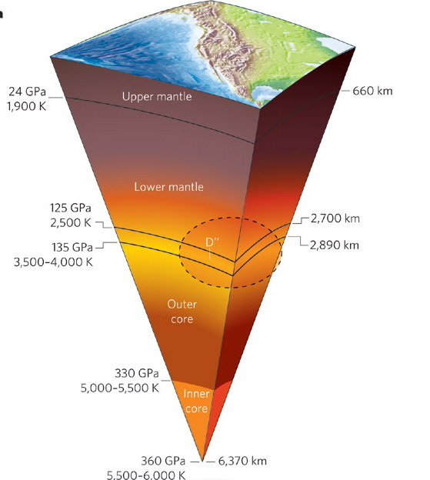
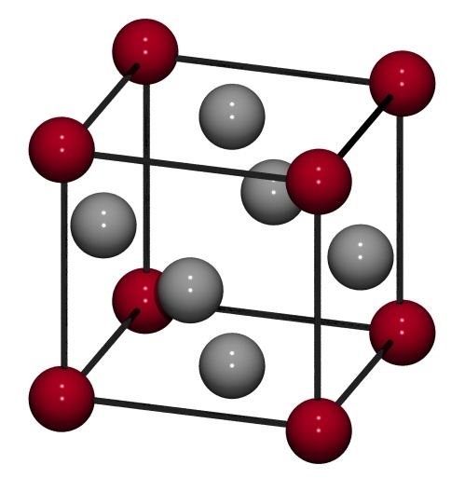
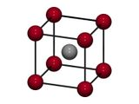

Earth Core Conditions
Temperature: 5000K-6000K
Pressure: 136-360 GPa
Approximately 3 million times the pressure felt at sea level.
Known structures of iron:
Face Centered Cubic (fcc).
Body Centered Cubic (bcc).
Hexagonal Closed
Packing (hcp).
fcc
bcc
hcp
http://www.nature.com
http://matdl.org/

Slide 7

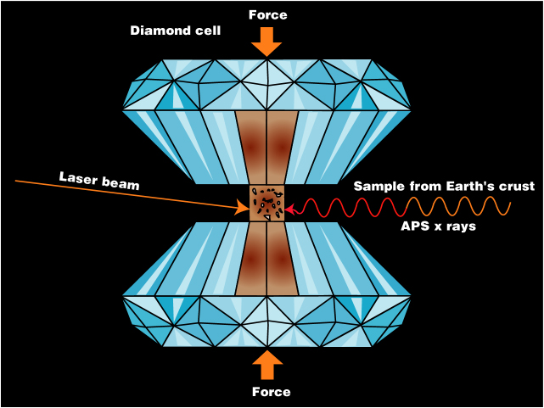
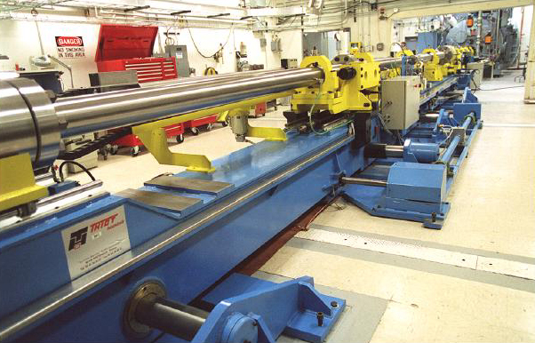
Exploration of Planetary Interiors
Using state of the art computers we can simulate the Earth’s core.
No Assumptions about the nature of chemical bonding.
http://upload.wikimedia.org/wikipedia/commons/
New Mexico
Supercomputer
Encanto
http://www.newmexicosupercomputer.com
https://wci.llnl.gov
It is possible to recreate the conditions of planetary cores in the lab or on computers.

Slide 8



Chemical Compositions
Supercells: Fe_{1-X}X_{X}
Host atom
Alloying element
2x2x1
8 atoms
x=0.125
Double x, y
Triple x, y
Double z
1x1x1
2 atoms
x=0.50
Different cell sizes simulate different chemical compositions.

Slide 9
Iron-Nickel Alloys
We are interested in how nickel (Ni) affects the elasticity of Fe,Ni alloys.
Specifically we studied alloys containing 12.5% Nickel.
A much needed knowledge baseline.
Understanding the properties of iron-nickel alloys forms a baseline for further research.

Slide 10
Iron-Nickel Alloy Stability
hcp is the most stable.
bcc is the least stable.
hcp favored by Stixrude et al. (1995)
bcc favored:
Belonoshko et al. (2008)
fcc favored:
Mikhaylushkin et al. (2007)

Slide 11
Elasticity of hcp: (Fe_{0.875}Ni_{0.1257})
C₄₄ is most greatly affected.
Shear properties are mostly affected.
Notes:
C44 is the elastic constant. The higher the C44 the harder is is to deform the solid. Determines the propagation of shear waves. The Higher C44 is the high the wave velocity.

Slide 12
Isotropic Velocities
Oxygen affects elastic properties more than Si and S.
Candidate for light element in the Earth’s core.

Slide 13
Summary
Hcp-type (Fe,Ni) alloy is most stable structure at least at low temperatures.
Nickel affects mainly shear elasticity of (Fe,Ni) alloys.
Small amounts of oxygen are possible without affecting stability.
Oxygen may be prime candidate for light element.

Slide 14
Future Research
Complete a knowledge baseline of the Iron-Nickel alloys.
Extend research to high temperatures
Newton’s 2nd Law: F = m a.
Dynamics (MD).
Determine chemical conditions at formation of the core: oxidizing (O) vs. reducing (Si, S).
Better understand the evolution of the Earth and other planets.

